Slide 1


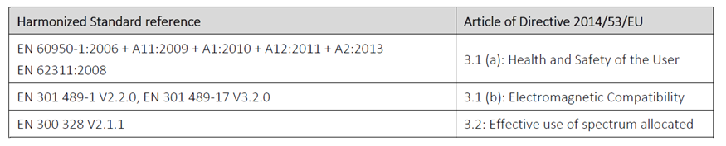
Hypertherm, Inc.
P.O. Box 5010
21 Great Hollow Road
Hanover, NH 03755 USA
UKCA DECLARATION OF CONFORMITY
Mechanized Plasma Arc Cutting Systems in the table below: Including power sources with built in WiFi module, ignition consoles, gas consoles, torch & lead assemblies, chillers, cooling units, pump motor, consumables, and spare parts are in conformity with the relevant UK Legislations.
Model | P/N(s) | Date UKCA mark first affixed | Unit(s) Tested
XPR300 | 078625, 078626 | 11-Nov-2022 | Alpha 11
XPR170 | 078645, 078646 | 11-Nov-2022 | PA2
Date of this DofC: November 11, 2022
This declaration of conformity is issued under the sole responsibility of the manufacturer.
The undersigned official of the company hereby declares, on behalf of Hypertherm, Inc.,
that the above units with UKCA Marking on the data plate meet the essential requirements
of the following UK Legislations and Designated Standards:
Electrical Equipment (Safety) Regulations 2016
  Hypertherm maintains a safety test report to the following UK designated standards
  using Hypertherm safety testing instructions ES2214:
BS EN IEC 60974-1:2018+A1:2019 Arc welding equipment – Part 1: Welding power sources
BS EN IEC 60974-2:2019 Arc welding equipment – Part 2: Liquid Cooling Systems
BS EN IEC 60974-3:2019 Arc welding equipment – Part 3: Arc striking & stabilizing devices
BS EN IEC 60974-7:2020 Arc welding equipment – Part 7: Torches
  BS EN IEC 60974-8:2021 Arc welding equipment – Part 8: Gas Consoles
2014/53/EU Radio Equipment Directive & 2014/30/EU Electromagnetic
Compatibility directive
Wi-Fi Module: Telit GS2011MIE (700-0045) or GainSpan GS2011MIE
Per Telit/GainSpan EU DECLARATION OF CONFORMITY [20560DOC00052A Rev.6]:
Notes:
1

Slide 2
  Electromagnetic Compatibility Regulations 2016 & Radio Equipment Regulations 2017
  Testing Laboratories generated test report #’s (in below table), and Certificates of Conformance to the following UK designated standards:
  BS EN 60974-10:2014/A1:2015 – Arc welding equipment – Part 10: EMC requirements
  EN 301 489-1 V2.2.0 – ElectroMagnetic Compatibility (EMC) standard for radio equipment and services; Part 1: Common technical requirements
  EN 301-489-17 V3.2.0 – ElectroMagnetic Compatibility (EMC) standard for radio equipment and services; Part 17: Specific conditions for Broadband Data Transmission Systems
The Ecodesign for Energy-Related Products and Energy Information Regulations 2021
IEC 60974-1:2021 Arc welding equipment – Part 1: Welding power sources
Michael C Scheller
Michael Scheller
General Manager, Mechanized Plasma - Management
Note 1: The Technical Construction File including the test reports and other information required by these UK Legislations is maintained at the above address. This UKCA DofC is not valid on units without UKCA Marking on the data plate. The plasma cutting power sources manufactured by Hypertherm are not within the definition of machinery or within the scope of the Supply of Machinery (Safety) Regulations 2008.
Note 2: For product information or the contents of this declaration, please contact:
EMEIA Corporate Headquarters +31(0)88 497 3737
EMEIA Customer Service 00800 332 497 37 Toll Free +31(0)88 497 3727
EMEIA Technical Service 00800 497 378 43 Toll Free +31(0)88 497 3700
EMEIA Marketing +31(0)88 497 3708
technicalservice.emea@hypertherm.com
Model | Test Report Number(s)
XPR300 | TUV SUD - NC72140087.1, NC72140087.2
XPR170 | Intertek - 103352798BOX‐001

